Slide 1
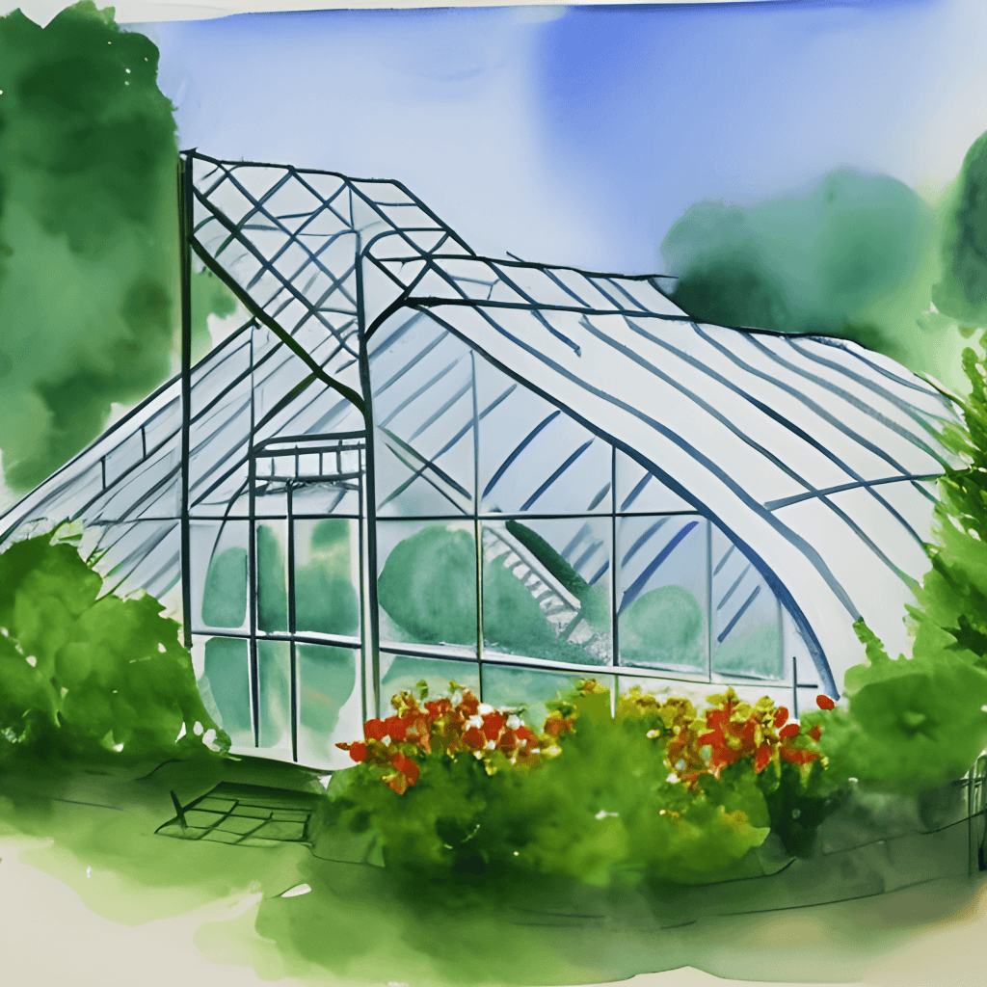
Smart Greenhouse
ES-42422: Embedded System Architecture
Ma Khin Pyae Phyo San
6hpc-114

Slide 2
Outline
Introduction
Objective
Implementation
Result and Discussion

Slide 3
Introduction
For ambitious farmers who wants to improve the yields from his Greenhouse by using intelligent irrigation system.
The irrigation system contains servo motors that control the water supply to the Greenhouse, based on the present humidity, temperature levels.
Machine learning model that predicts how much water (in percentage) should be supplied to the farm by using sensor data.
Does not want to water the plants during nighttime.

Slide 4
Objective
The sensor data from the irrigation system needs to be transmitted to a machine learning model, which will then generate the accurate signal (representing the percentage of water flow) to manage the supply of water.

Slide 5
Implementation
Components:
Arduino Mega Board
a single Multi
Layer Perceptron (MLP) Model deployed, which has been trained on a dataset a priori to the simulation.
DHT22 sensor to detect temperature and humidity.
Servo Motors to control the water flow.
LCD to display the percentage of each water supply unit.
Photoresistor sensor to detects time of day as either day or night.

Slide 6
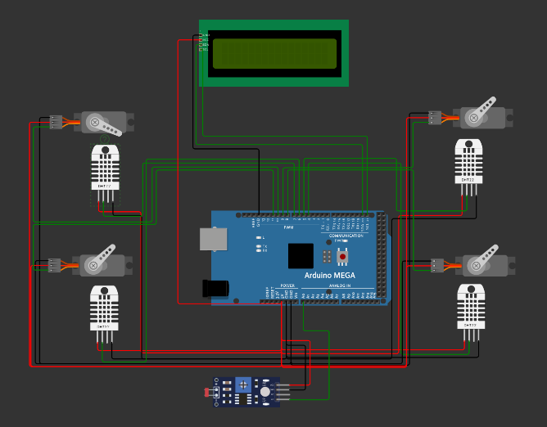
Implementation
Architecture Diagram

Slide 7
Implementation
The arduino process the data sent by photoresistor sensor (AO) and forecast day and night.
If Day, value is above 50.
DHT22 sensor values sent to arduino board and apply min max scaling.
t = 50, min = 20, max = 100. Then new t = (t-min)/(max−min)
Servo motor angle = (water percentage ∗ 180)/100

Slide 8
Implementation
from sklearn.metrics import mean_squared_error model = MLPRegressor(activation='relu', hidden_layer_sizes=(16,8),random_state = 56, max_iter=8000).fit(x_train, y_train) y_pred = model.predict(x_test) rms = mean_squared_error(y_test, y_pred, squared=False) print("r2_score: ", (r2_score(y_pred, y_test)), ",accuracy",model.score(x_test, y_test), ",rmse:",rms)
This line creates an instance of the MLPRegressor class (a type of neural network for regression), sets its activation function to 'relu', specifies two hidden layers with 16 and 8 neurons respectively, sets a random seed (random_state) for reproducibility, and sets the maximum number of iterations to 8000. It then fits (trains) the model using the x_train input data and corresponding y_train target data.

Slide 9
Result and Discussion
Demo Here

Slide 10
Thank You!

